Slide 1


Building Position Sensing System for the Test Mass of the OmniSens
- a Technology for the Einstein Telescope at Low Frequency Science
Zhao-Qing Lin
Supervisor: Dr. Conor Mow-Lowry
Daily Supervisor: Dr. Michele Valentini

Slide 2
Content
Gravitational Waves
Detectors and Low Frequency Science
The OmniSens Project
Position Sensing System of Test Mass
Setup and DAQ
Capacitor Position Sensing (CPS)
Homodyne Quadrature Interferometers (HoQIs)
Results and Discussion
Blended Sensing Test
Offset analysis
Future investigation
Notes:
My talk includes 4 parts.
First, I will briefly introduce gravitational waves detection and the low frequency science we are working on.
The omnisens is contributing to the low frequency sicence of the gravitation wave detection, and also where my sensors are working on.
My work includes building highly sensitive position sensing system around the test mass, that is combined with an absolute position sensor and a higher resolution relative sensor.
Finaly I will share some interesting discoverty of the functional test of the sensing system.

Slide 3
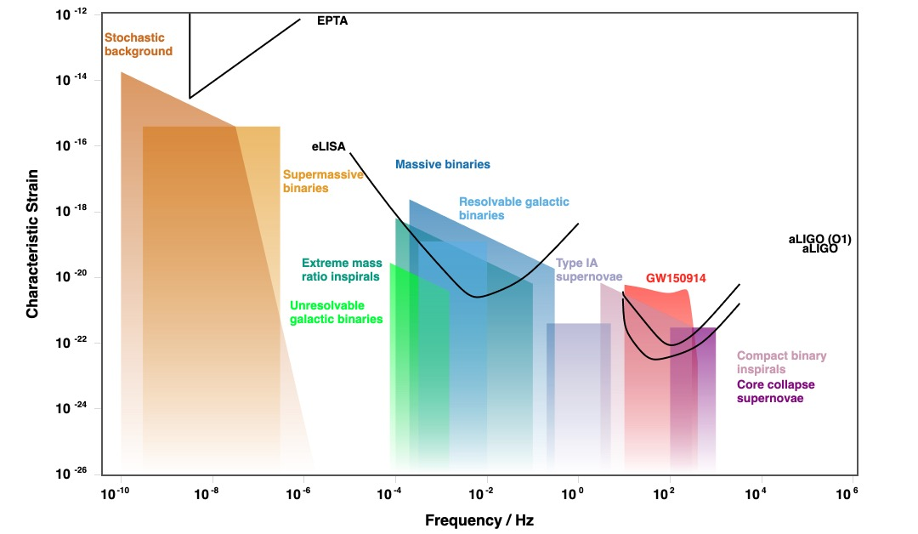
Science of Gravitational Waves
Gravitational Waves
General Relativity:
Mass -- Spacetime
Scientifically important:
Propagates with low loss
Brings information from early universe
Generates before the event happens (BHBH) -- multi-messenger astronomy
Notes:
General relativity connects the gravity generated by mass to the geometry of spacetime. Intense cosmological events can distort spacetime and this distortions propagates through the universe as ripples. That’s what we called gravitational waves.
The figure below shows a spectrum of gravitational waves from different cosmic sources, along with the sensitivity bands of several gravitational wave detectors.
Being a unique messenger, gravitational waves have many crucial properties that are make them worth continue exploration. Such as they propagate the information with minimum loss; they allow us to see the universe that are inaccessible to light, including the very early universe. For typical sources for gravitational wave like binary star mergers, the gravitational waves are emitted before the mergesr happen. By detecting the signal during this process, it creates a time window to inform other messenger to follow up, starting a new era of multi-messenger astronomy.

Slide 4
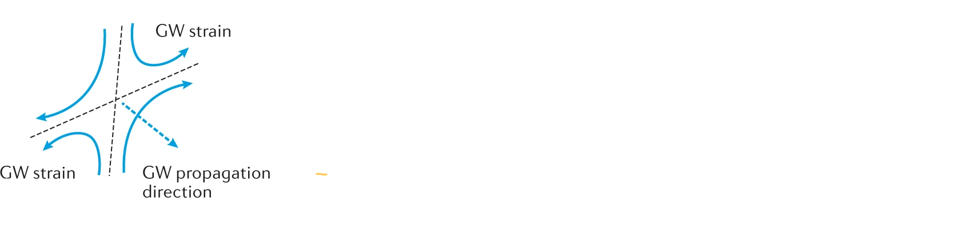
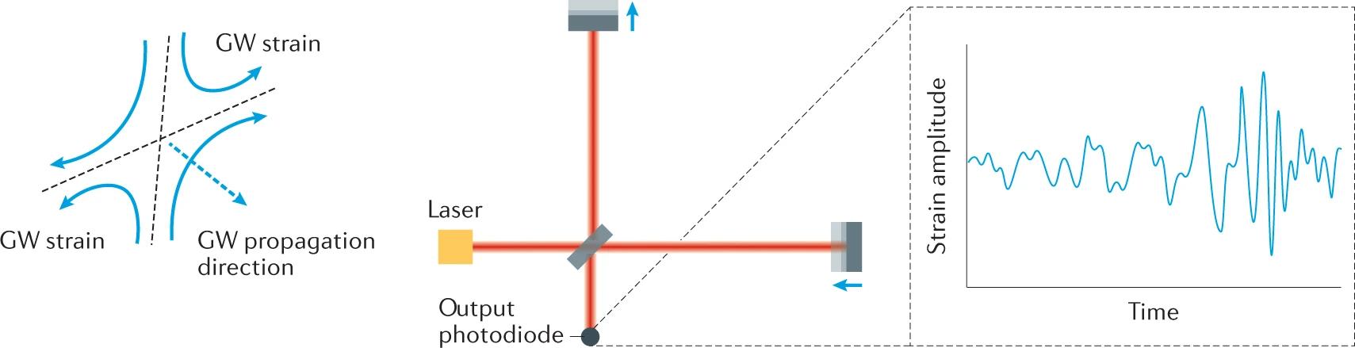
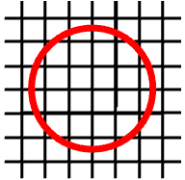
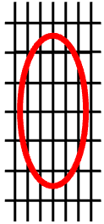
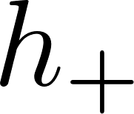
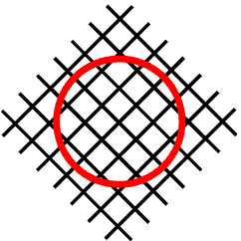
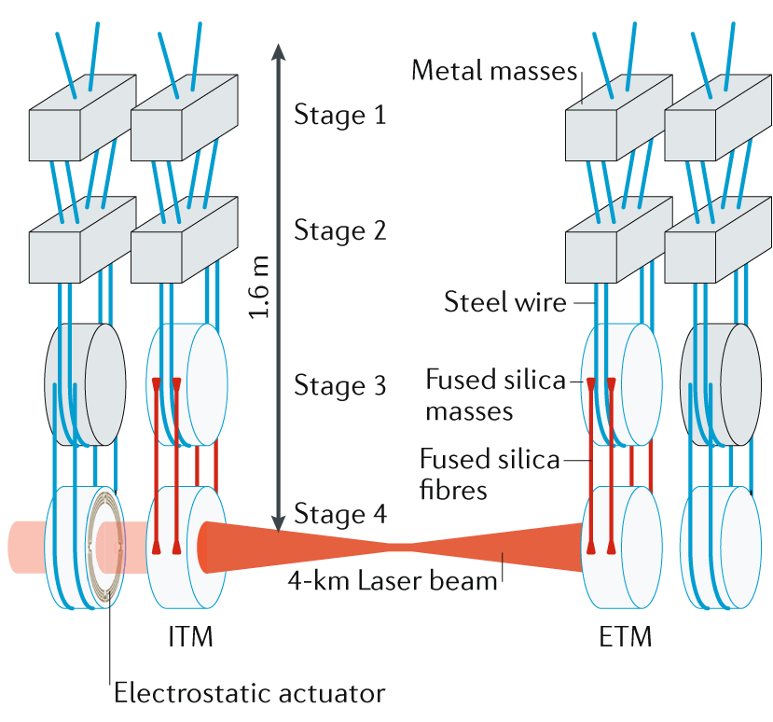
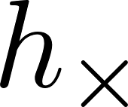


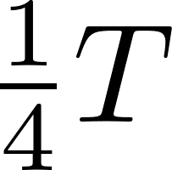
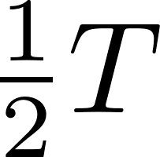
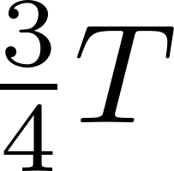

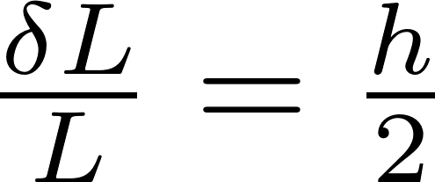
Detectors: Interferometer
Detectors and Low Frequency Sciences
plus polarization
Optics
cross polarization
Time
Suspension
Extremely difficult to detect
Notes:
gravitational waves have two polarizations, each of them squezz and stretch spacetime in the perpendicular direction. The strain of a gravitational wave is defined as the ratio between the change in size of a free-falling object and its original size.
The detectors use an interferometer to measure changes in the light path between softly suspended mirrors. To detect the signal from the first directly observed gravitational wave, LIGO had to measure a length change on the order of 10to the order −18, which is extremely small and difficult to detect.
This level of sensitivity requires detectors with extremely low noise. The suspension system allows the mirrors to behave as nearly free-falling test masses, isolating them from external vibrations not caused by gravitational waves.

Slide 5
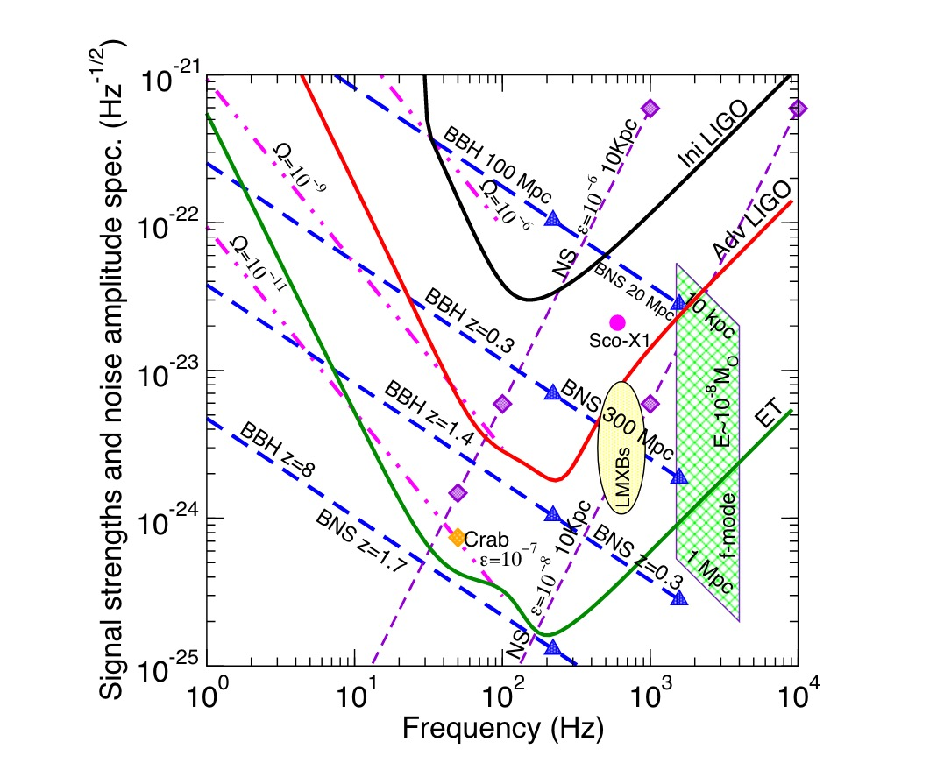
The Einstein Telescope: LF-HF
Detectors and Low Frequency Sciences
ET
Notes:
ET is the third gravitational wave, with ambitious goals for better sensitivity and longer observation time, particularly at low frequencies.
This enhanced performance enables the discovery of more massive and earlier binary mergers, contributing to major breakthroughs in astrophysics and fundamental physics.
ET proposes to use two sets of detectors: a low-frequency interferometer and a high-frequency one. These channels are optimized for different frequency ranges and work together to provide broad-band sensitivity.

Slide 6
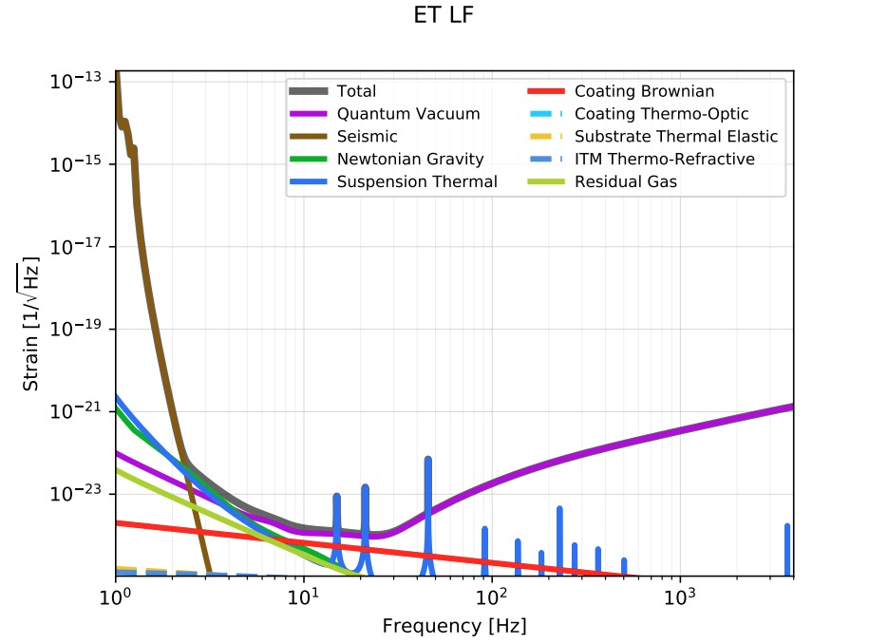
Low Frequency Science
Detectors and Low Frequency Sciences
Scientifically Important:
Bigger redshift -- earlier universe
More massive binary systems
Longer time in the sensitive band
Difficult to Suppress
Low-pass filter
ET
Notes:
Low frequency gravitational waves detection is scientifically very important but technically challenging. The gravitational waves at low frequency carry information from earlier universe with larger redshifts; and in the binary stars system, lower frequencies correspond to more massive objects.; Early detection at low frequencies also extends the observation time within the detector’s sensitivity band.
The challenge in detecting low-frequency gravitational waves is that noise is harder to suppress at lower frequencies. This is because most attenuation mechanisms act as low-pass filters—they effectively reduce high-frequency noise but allow low-frequency disturbances to pass through.
On the right is the strain noise budget of the Einstein Telescope (ET) Low-Frequency interferometer. A noise budget shows the contributions of different noise sources across the frequency spectrum. Gravitational wave signals can only be detected if their strain amplitude is above the total noise at a given frequency. In the OmniSens project, we focus on suppressing seismic vibrations, which dominate below 2 Hz.

Slide 7
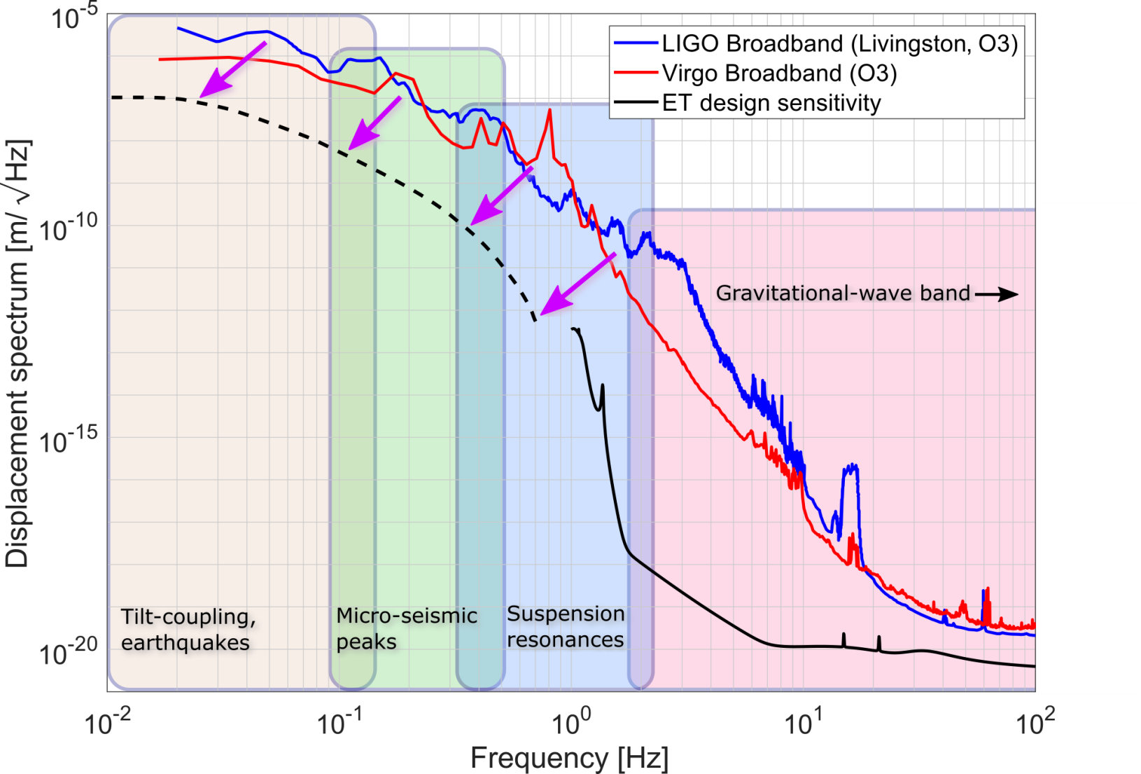

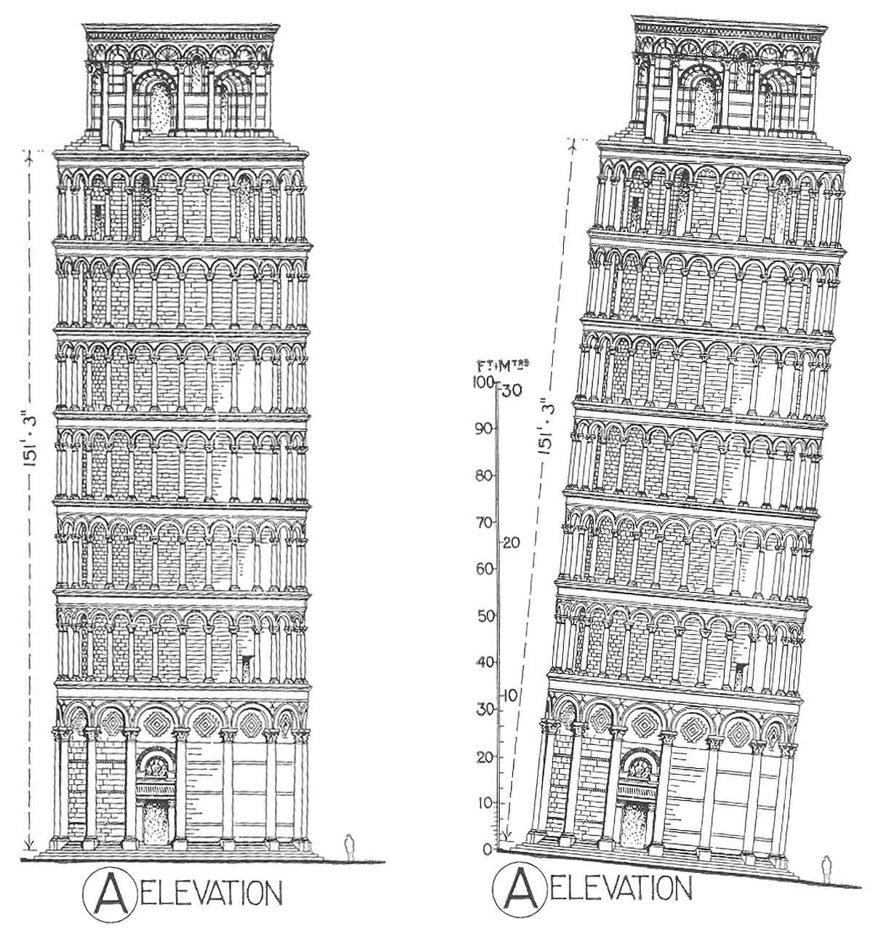



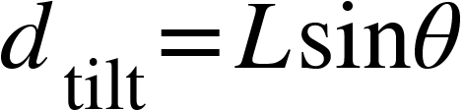
Seismic Noise: Tilt-Horizontal Coupling
Detectors and Low Frequency Sciences
The non-linearity couples the noise in low frequency to high frequency
10⁶ improvement at 3 Hz
Notes:
The Einstein Telescope (ET) aims to detect gravitational wave signals down to 3 Hz, requiring a sensitivity improvement of up to 10 to the order of 6 times at that frequency.
The figure on the left shows the various noise mechanisms contributing to seismic noise.
One major challenge is tilt-horizontal coupling, which dominates below 100 mHz. Tilting of the suspension system introduces horizontal translation due to gravitational acceleration. The OmniSens project introduces a novel design that reduces both tilt coupling and the force noise associated with stabilizing the suspension system.

Slide 8
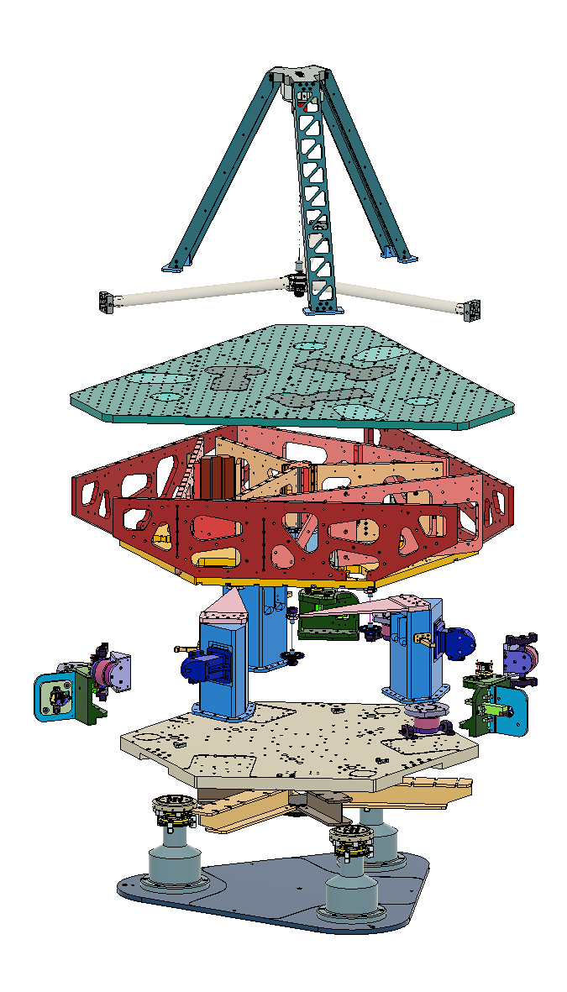
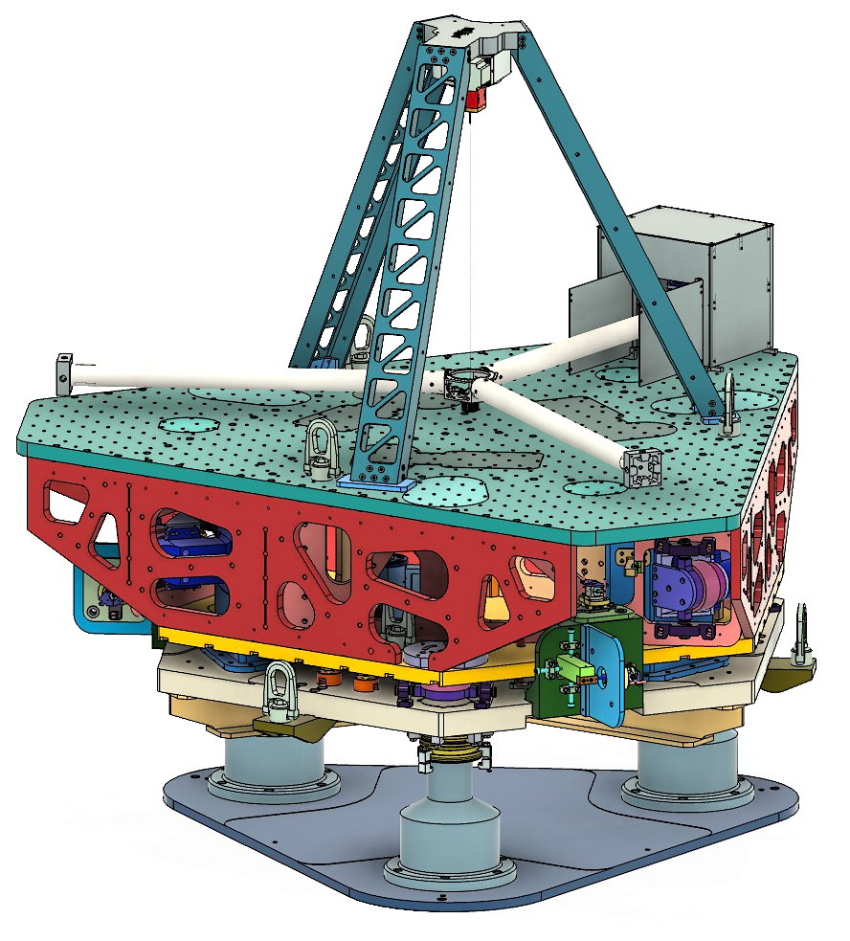
The OmniSens Inertial Isolation System
The OmniSens Project
Inertial Sensors
Test Mass
Stage 1
Active Platform
Drag-free control
Stage 0
Base
Notes:
OmniSens is an inertial isolation system that combines an inertial sensors with drag-free control.
Inertial sensors measure the variations in object’s (the blue frame) motion with respect to a free-floating test mass (the yellow block in the middel) as inertial reference. Common inertial sensors include accelerometers and geophone. A drag-free control is used to transfer the inertial stability to the target object through controller.
On the right is the design and the layered structure of the omnisens. From top to bottom, the components are: a three-arm test mass suspended by a silica fibre; the active platform (Stage 1) that follows the text mass by the drag-free control; and the base (Stage 0) that hangs the stage 1 and is attached to the ground.

Slide 9
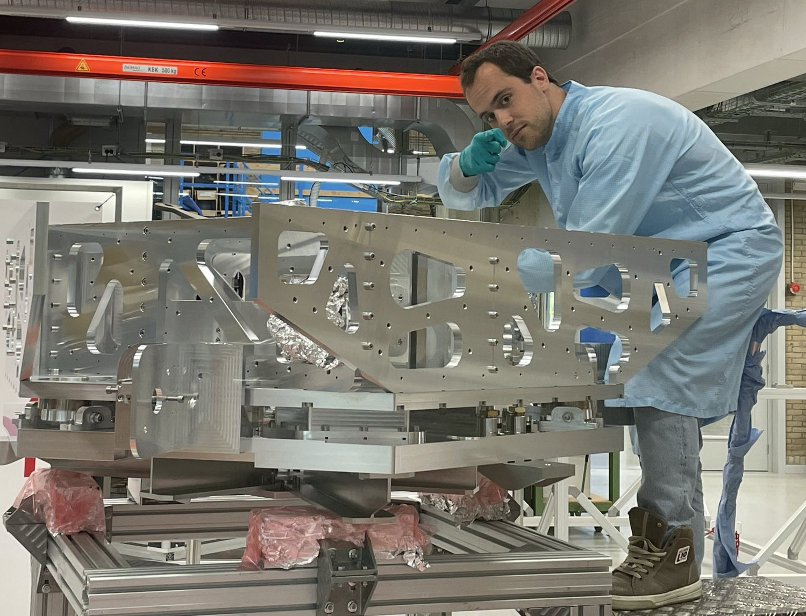
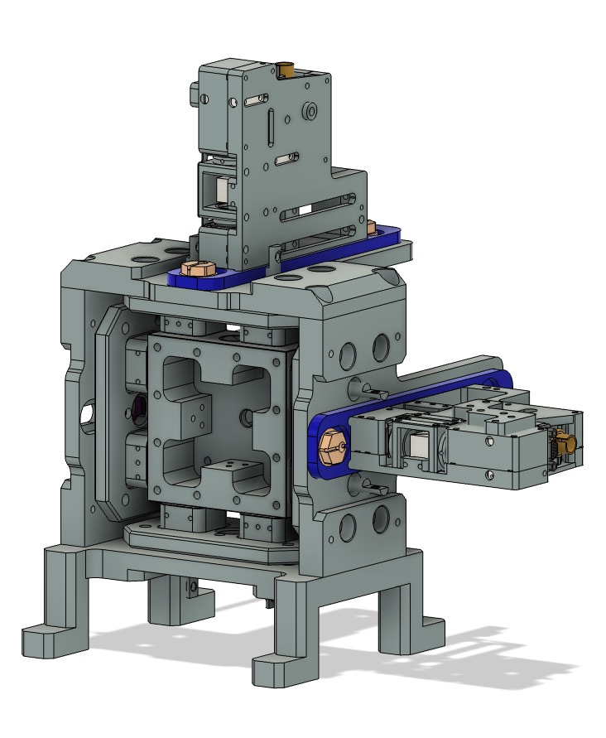
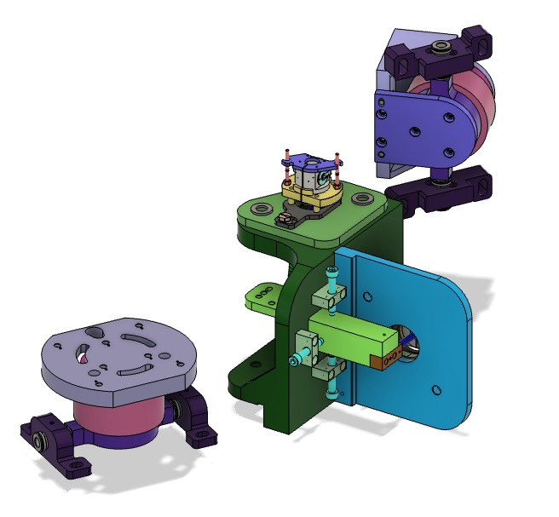
Working Principle
The OmniSens Project
Passive:
Blades, flexures and silica fibre
b) Softly suspended
A)
Test mass
Active platform
a) Blades
Flexures
B)
Active:
Displacement sensors and actuators
Passive:
Soft suspension
Low tilting resonant frequency
Active:
Precise position sensing system
Robust control system
...
A)
B)
Tilt-horizontal decoupling
Low force noise
Small dynamic range
...
Qing’s project
Notes:
The OmniSens applies two mechanism for vibration isolation, the passive isolation by using blades, flexure and silica fibre that lowering the mechanical resonant frequency and increase the gradient of suppression of vibration in high frequency. The active isolation is the drag-free control scheme, we have two locations for the sensors are actuators. Around the end of test mass. Call it end mass. and between stage 0 and stage 1. Two conventional displacement sensors Bosom and CPS can position the test mass, and a high sensitive interferometer hoqi are used to measure the inertial sensors. Two actuators are keeping the omnisens at the set working point in difference frequencies.
The Omnisens have many advantages.

Slide 10
Working Principle
Displacement Sensors for Test Mass
CPS: Capacitor Position Sensors
Absolute position
Most importantly for finding the centre:
Zero output means centre regardless of the transfer function
Working point for the actuators is set to the centre for minimizing non-linearity
HoQIs: homodyne quadrature interferometer
Inertial movement
First use CPS to find the zero point of the test mass, then use HoQIs for the following inertial sensing
Notes:
My work is around the sensing system around test mass. There two sensors.

Slide 11
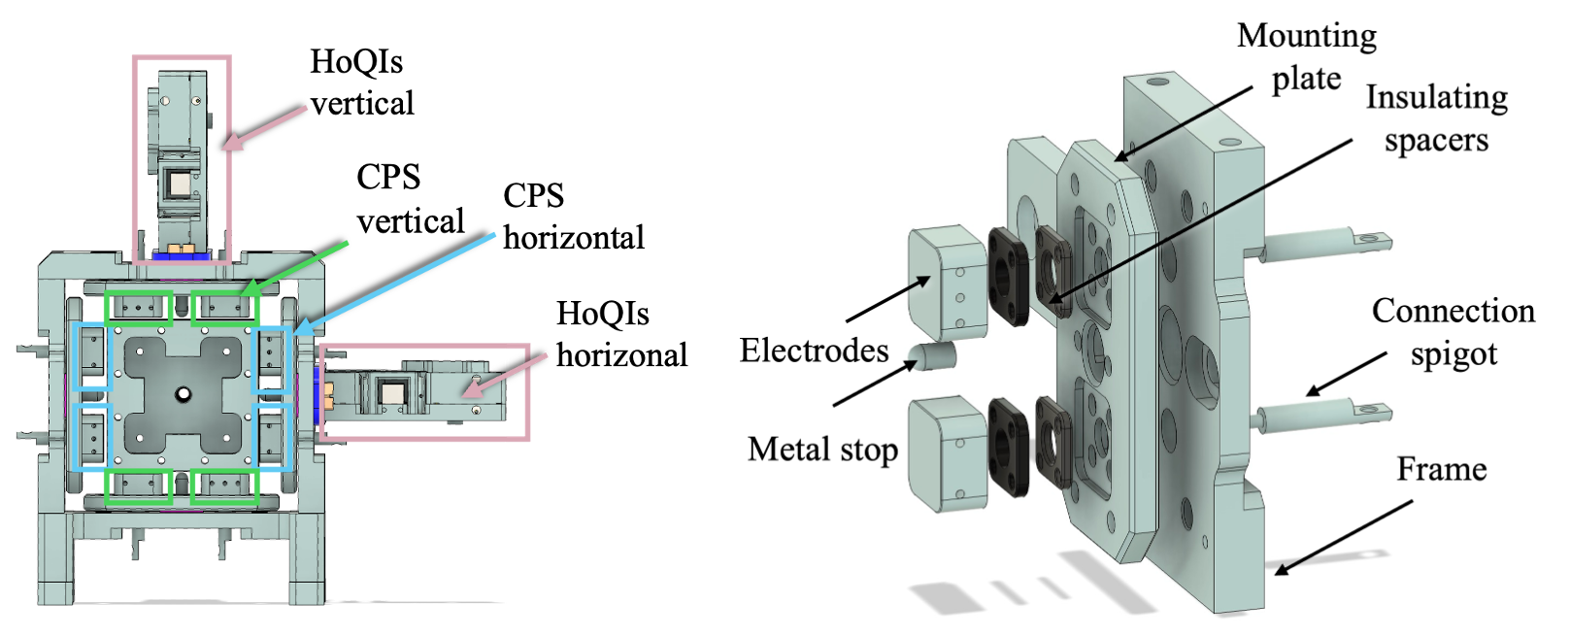
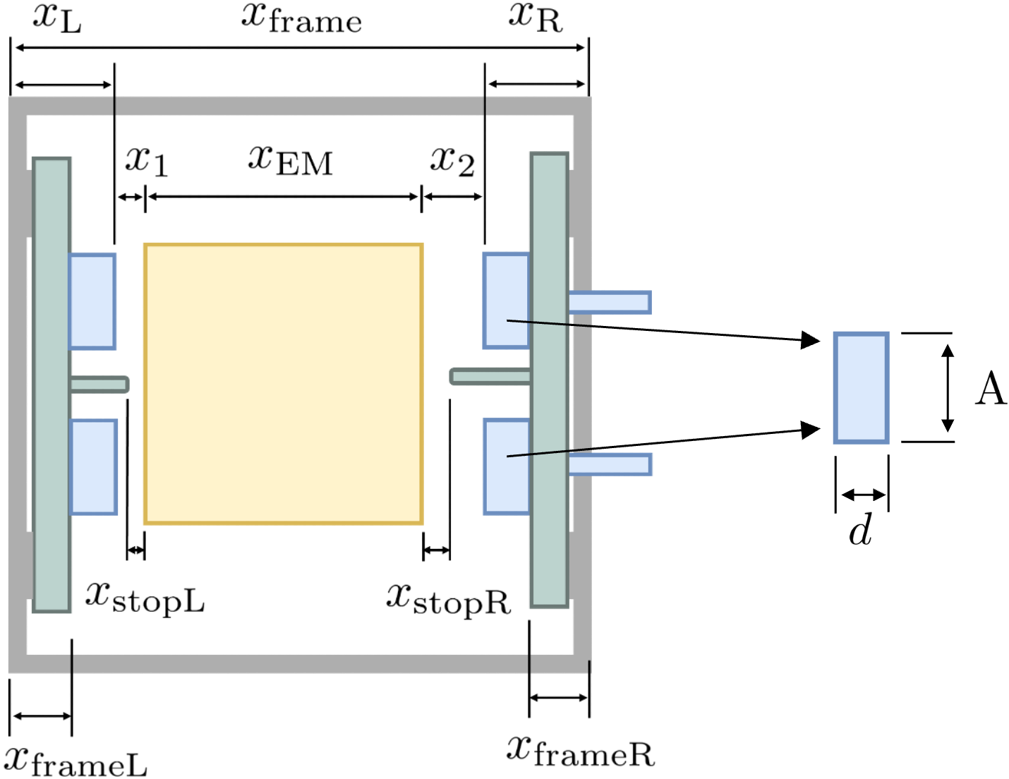
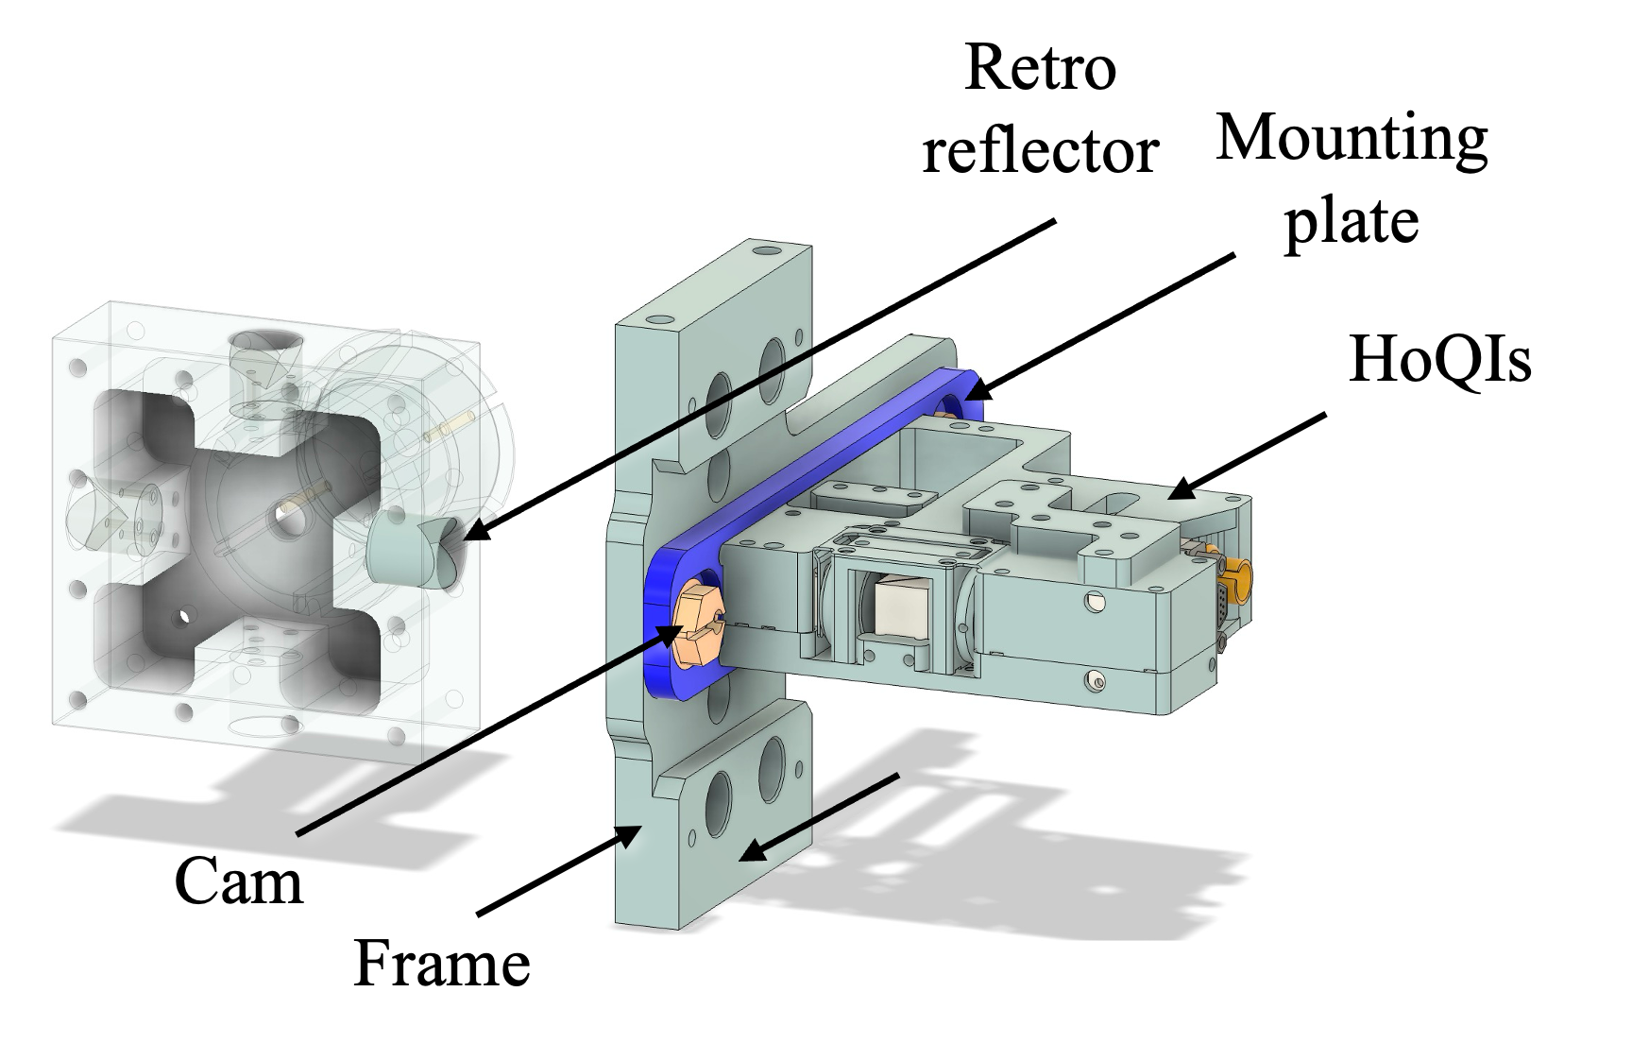
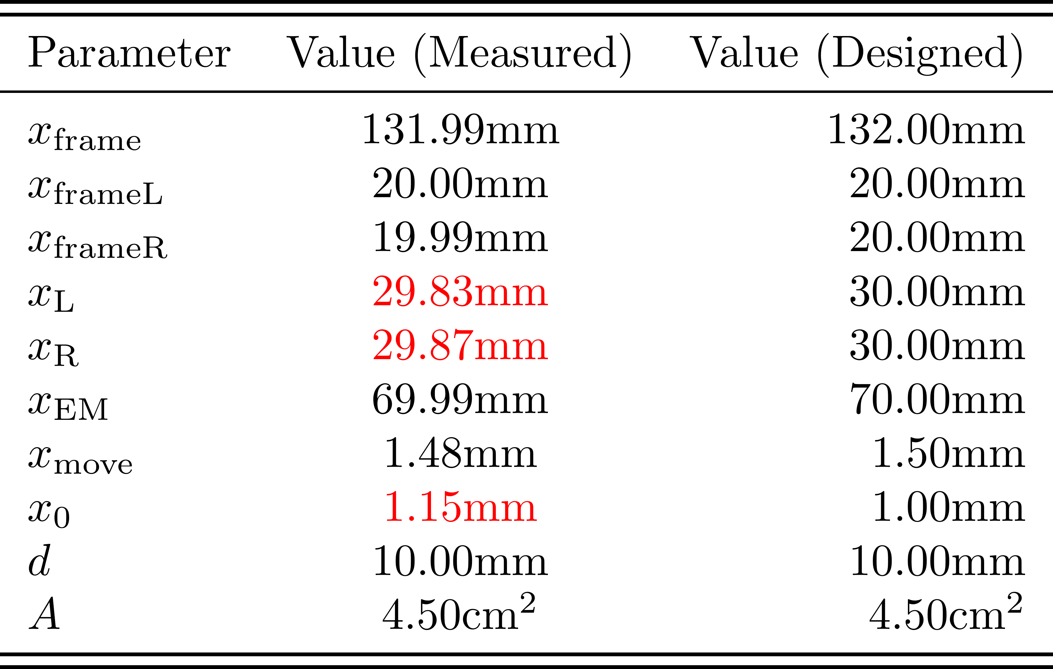
Setup
Displacement Sensors for Test Mass
Notes:
Mechanical set up on the test mass side. We have CPS and hoQIs and the horizonal and vertical direction, and my experiment is performed only on the horizontal one.
CPS are mounted on the inner frame, with two electrodes on one side, it is isolated from the metal frame. A metal stop is use to preven the test from hitting the electrode, when the test mass reached the limited moving range, the circuit is shortcutted, resulting a zero output.
Hoqi is an compact inter ferrometer that one retro reflector is on the test mass forming a test arm.
On the right is the mearsured and designed value for the end of test mass system. X0 x, difference

Slide 12
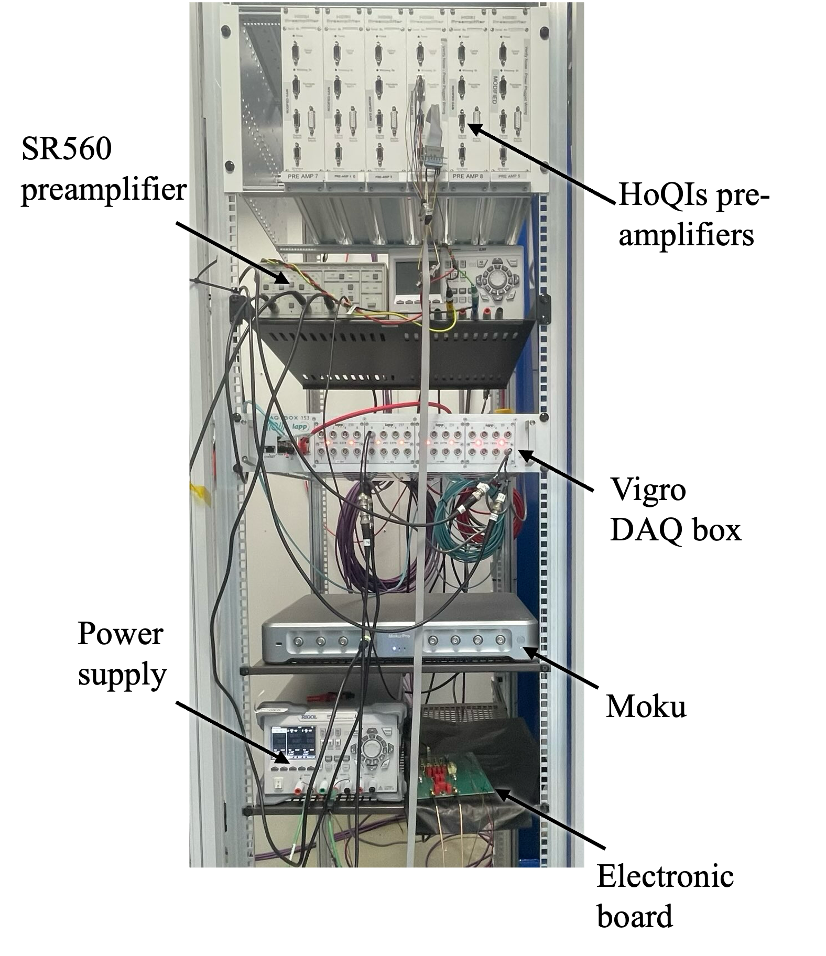
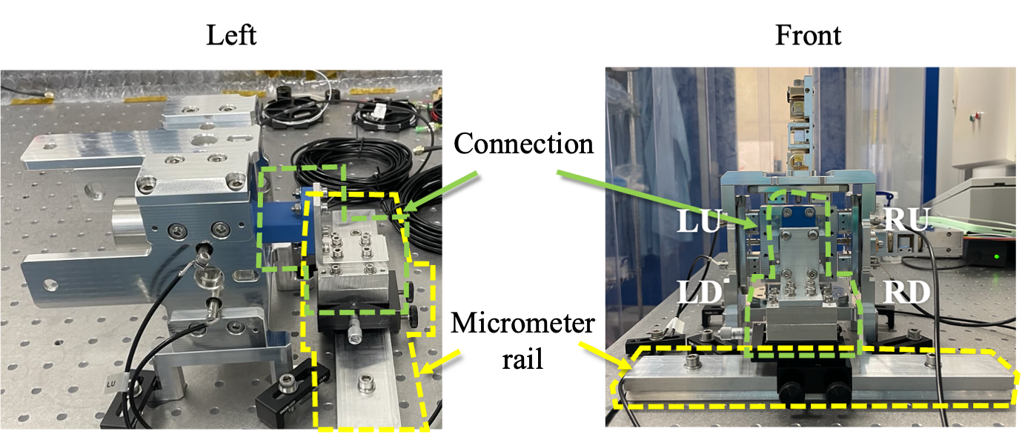
Setup
Displacement Sensors for Test Mass
Metal stop
Notes:
Lab set up.
Left is the structure, end mass is connect to mictrometer rail from a connector. Micrometer rail are used to apply a horizontal translation and read the location of the end mass.
On the right is part of the devices for data acquisition, among which there is a virgo daq box that acts as an interface for digital and analog signal converting to each other, and is connect to a real time pc, allow for remote real time daq and control.

Slide 13
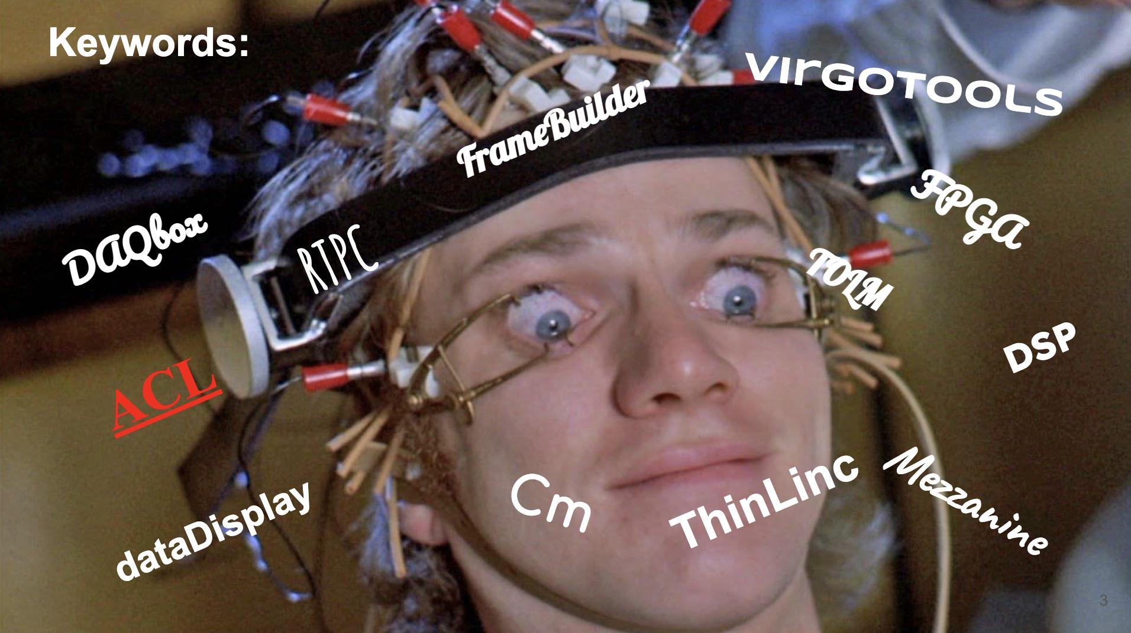
Absolute Position Sensing: CPS
Displacement Sensors for Test Mass
Differential capacitive sensing
DAQ and working scheme
Credit: M. Valentini
Notes:
CPS is using difference capacitive sensing method. The target is placed inside the electrode, forming two capacitor on opposite sides with the impedance denpending on two intervals. By finding the difference between voltage applied on the two capacitive, we can find a one to one correlation between the taget’s position in the electrode frams and the output voltage.
Input souce inject to the em from a input capacitor after amplification. The signal coming out from the electrodes are being

Slide 14
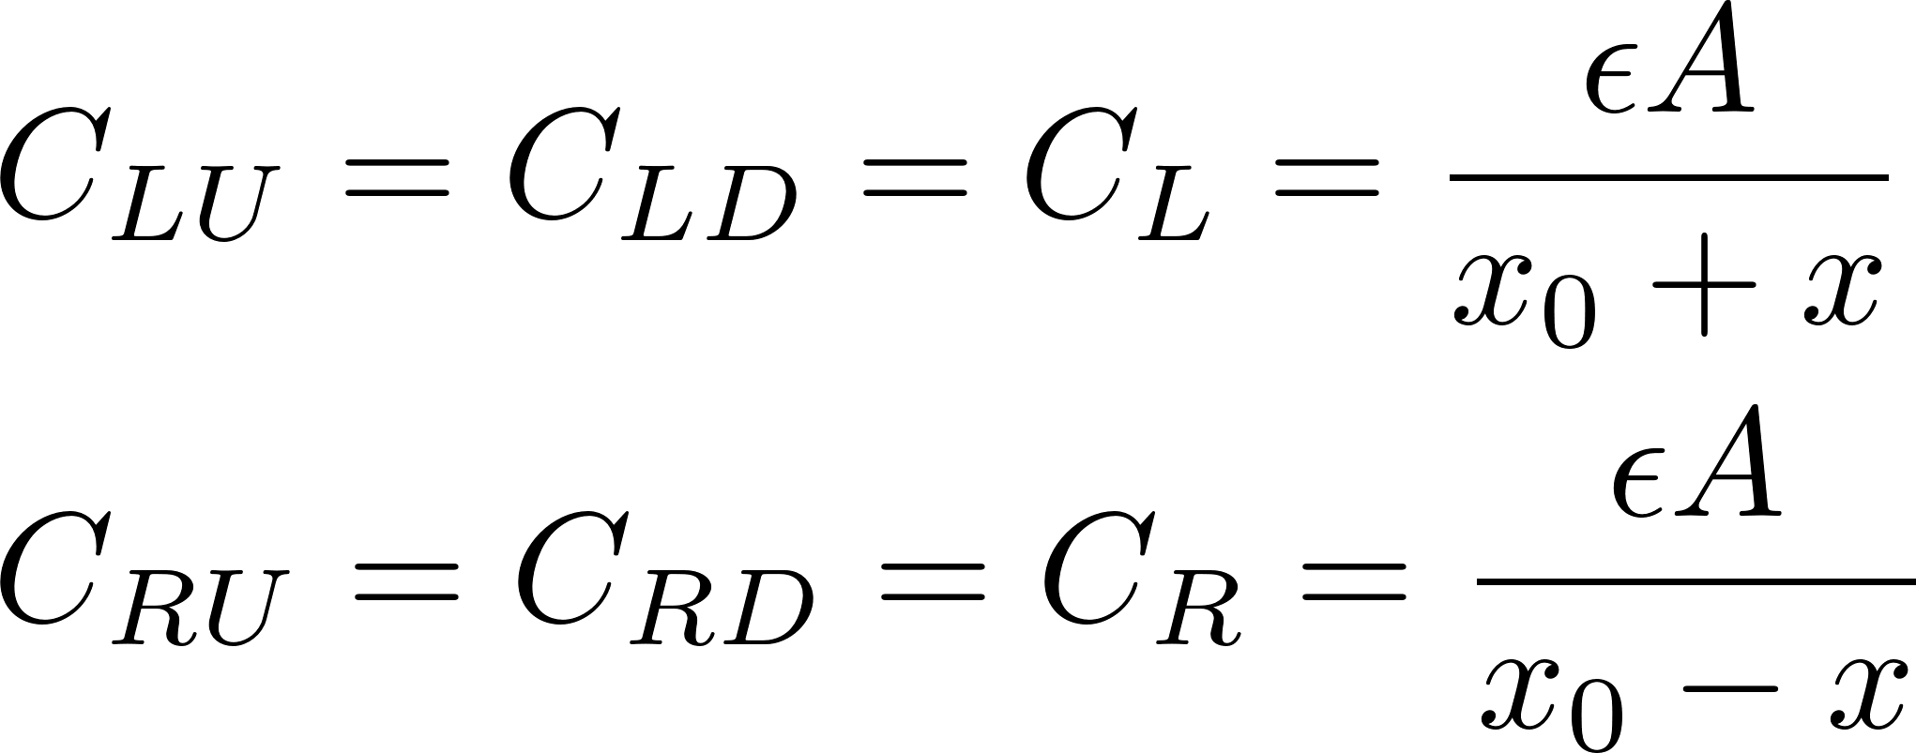
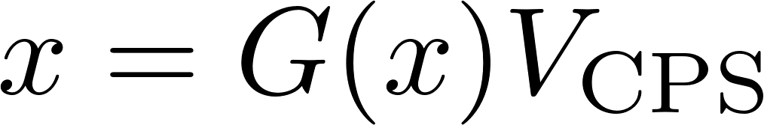
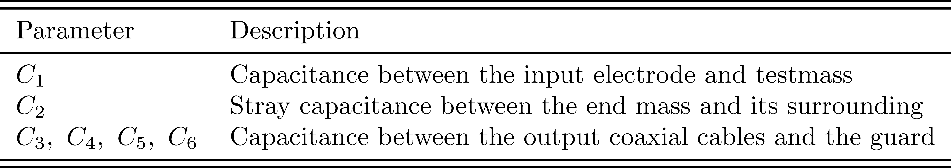
Analytical Transfer Function
Displacement Sensors for Test Mass
Free parameter space
Notes:
ideally the cps is independ on the cables
estimation of the relationship between the distance and the voltage read out. And we use the term gain to refer how many voltage means how many micros we move. F
解释模块

Slide 15
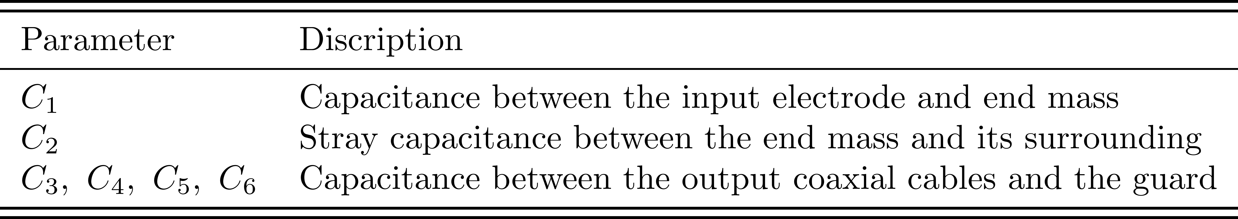
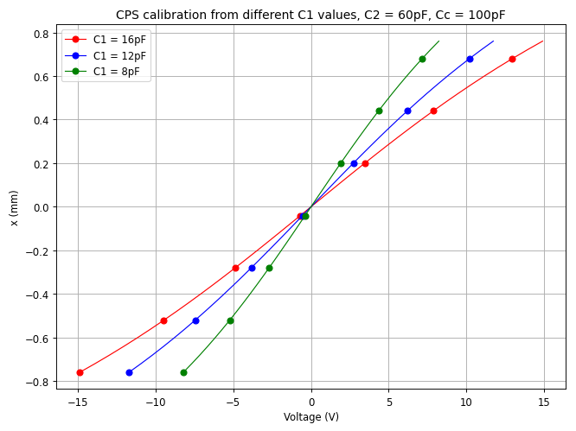
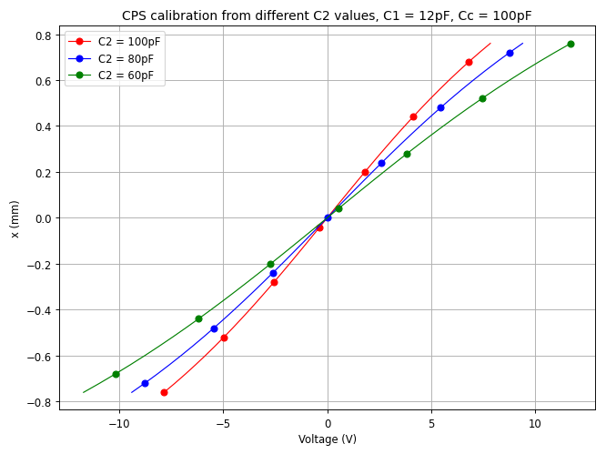
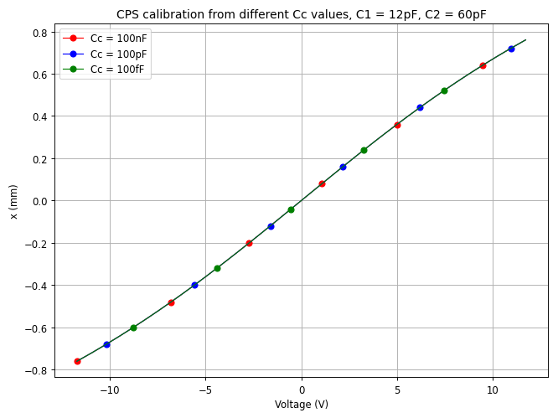
Analytical Transfer Function
Displacement Sensors for Test Mass
Parameter space
Gain is related to C1 and C2
Gain is unrelated to output cables
Notes:
ideally the cps is independ on the cables
estimation of the relationship between the distance and the voltage read out. And we use the term gain to refer how many voltage means how many micros we move. F
C1 increase, g increase, c2 increase, C
Small input capacitor
用名字来介绍

Slide 16
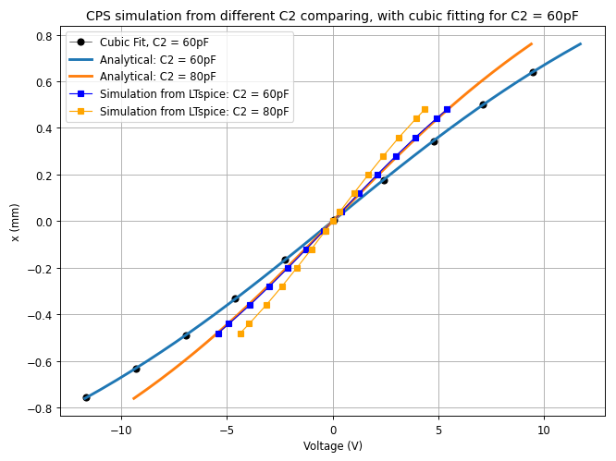

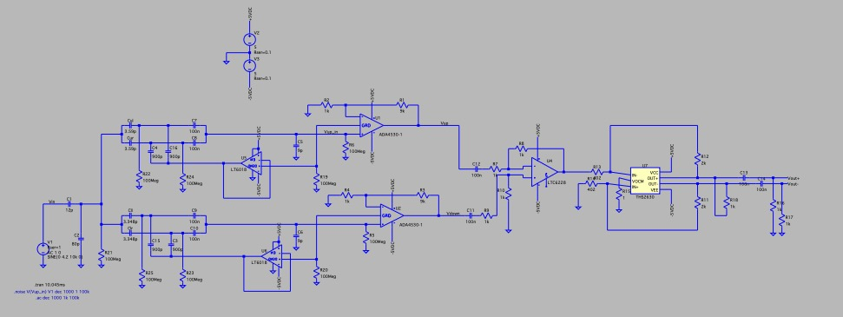
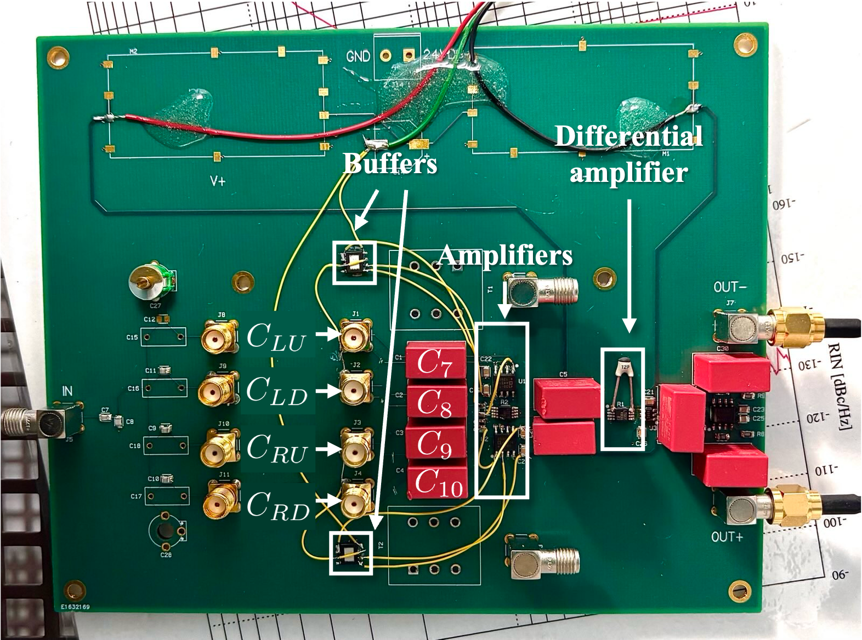
Simulation
Displacement Sensors for Test Mass
LTspice
Gain increases in simulation
Losing signal from components’ noise
Can use cubit fit for the curve
Cubit fit for C1 = 12pF, C2 = 60pF
Linear behaviour when working around the centre
Notes:
Simulation different from analytical
The transfer functions can be well approximated using a cubic fit.

Slide 17
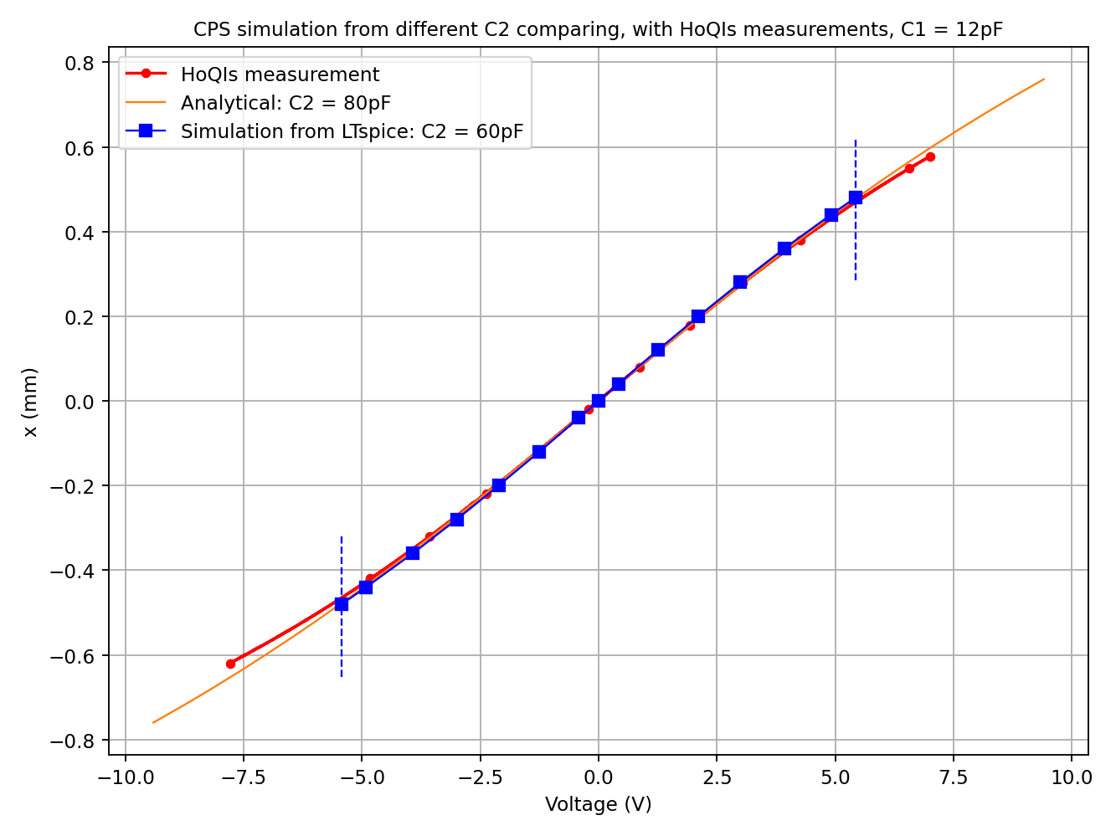

Analytical, Simulation and Measurement
Displacement Sensors for Test Mass
Measurement aligned well with the analytical model and simulation
_{CPS is working well}

Slide 18
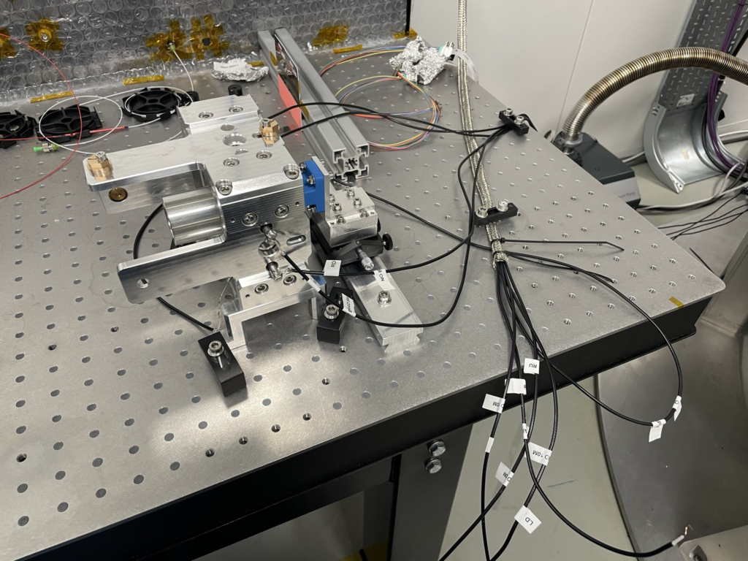
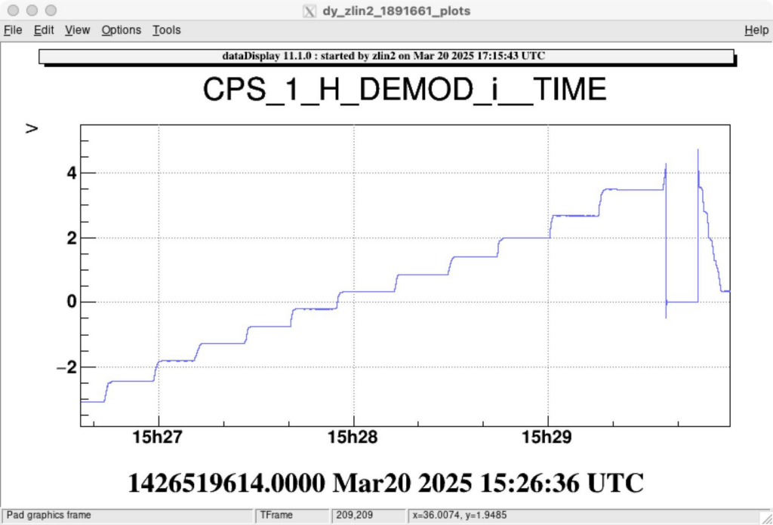
Noise Optimization and Board Upgrade
Displacement Sensors for Test Mass
Action
Distance
tuning
Add braid to reduce noise
Change cables to verify signal loss
Upgrade board to amplify signal
Change cables to see CPS’ independence of cables
Measurements
10m + old board
10m + old board + braid
5m + old board
10m + new board + braid
5m + new board
Time stamps
21st Mar. 2025
10th Apr. 2025
3rd May 2025
14th May 2025
15th May 2025
File names
CPS_10_n_B_old.npz
CPS_10_B_old_date.npz
CPS_5_n_B_old.npz
CPS_10_B_new.npz
CPS_5_n_B_new.npz
Gain
188μm/V (x₀ ~ 1.05mm)
480μm/V
111μm/V
99μm/V
96μm/V
Step scanning with constant distance
Gain measurement with micrometric rail
Gain is stable indeed
Notes:
我们upgrad了几次，最后优化到什么样子
Braid for reducing noise, board for compensate signal

Slide 19
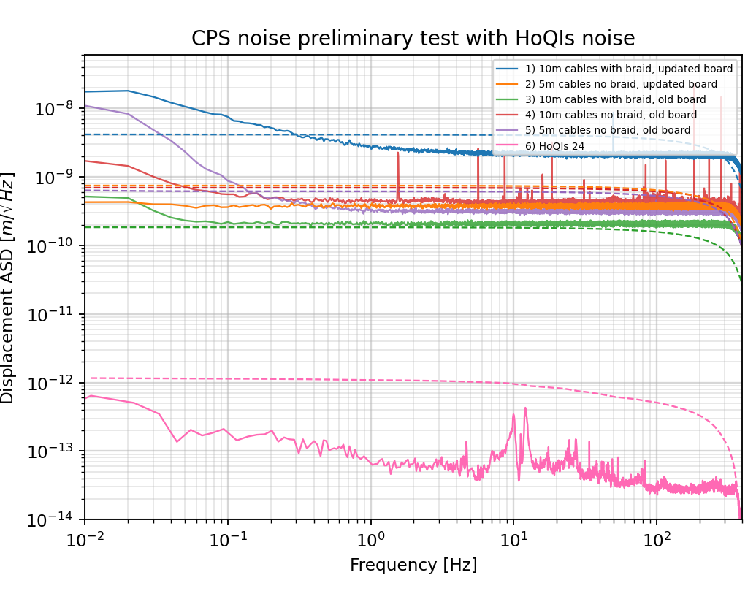
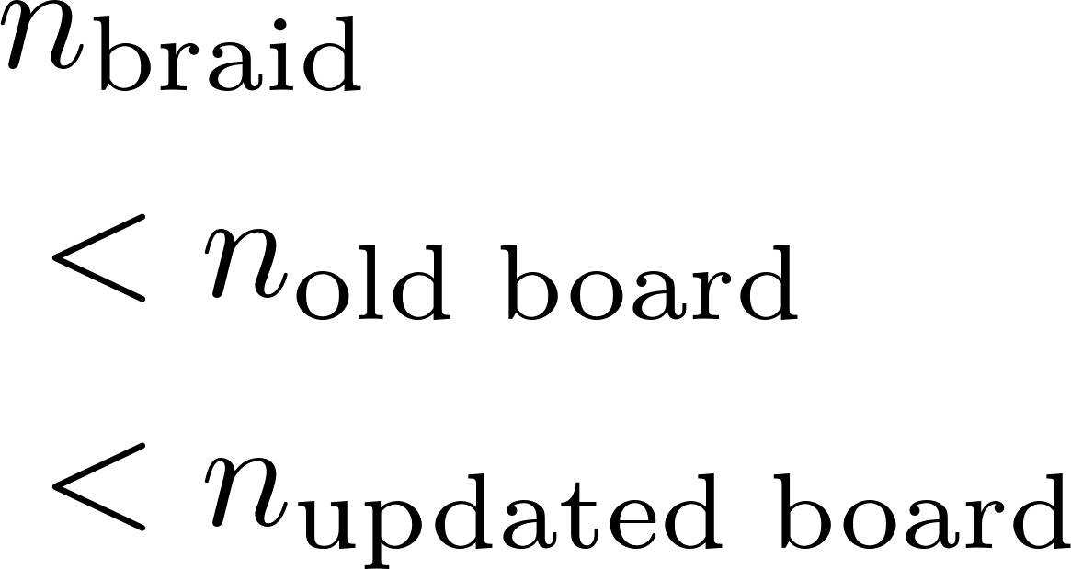
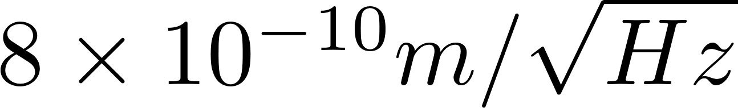
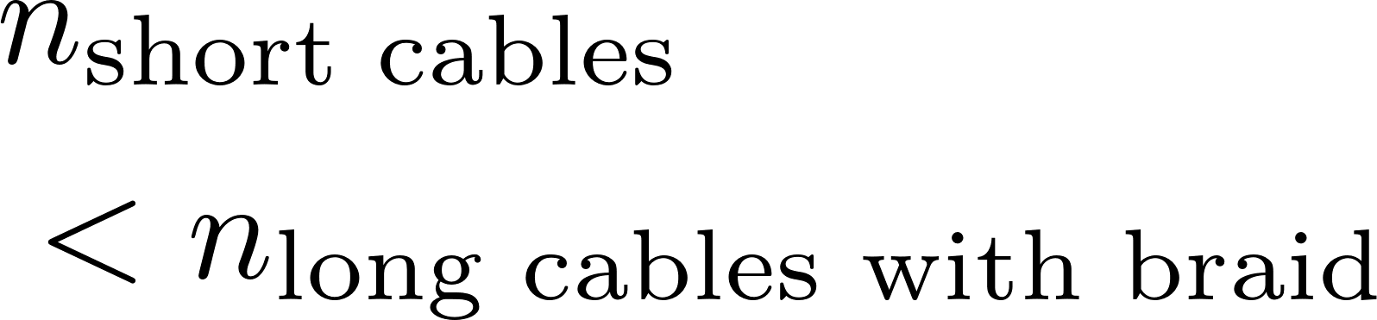
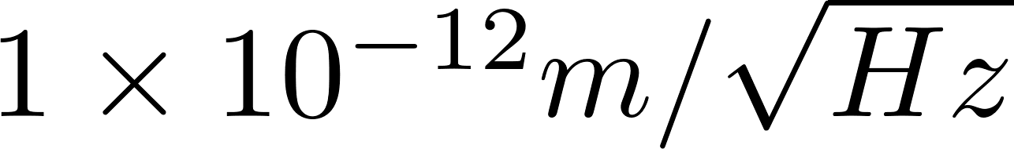
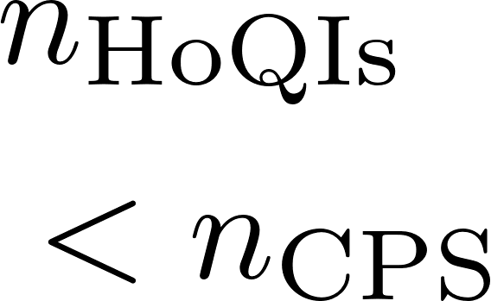
Noise Analysis: Optimization of Board and Cabling
Displacement Sensors for Test Mass
For the same cables
For the same board
For all frequency
👑
Notes:
data displace
put the test mass still

Slide 20

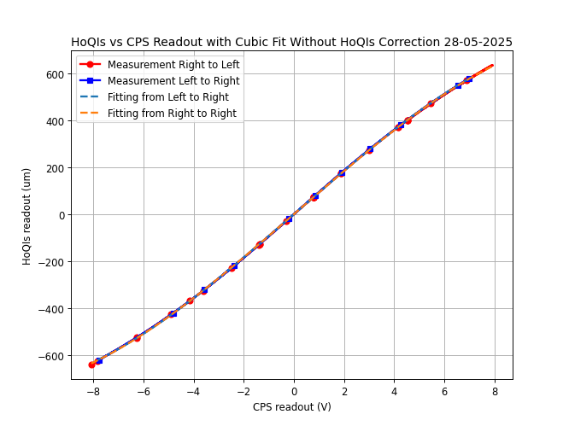





Possible Error: CPS Offset Check
Displacement Sensors for Test Mass
Biggest gradient point
sensing noise
Miscalibration force
_{loo}
Reasonable mechanical variable that are negligible

Slide 21




Relative Position Sensing: HoQIs
Displacement Sensors for Test Mass
Reference
Arm
TM
Credit: C. Mow-Lowry
Credit: C. Mow-Lowry
Notes:
Mach–Zehnder interferometer

Slide 22



Relative Position Sensing: HoQIs
Displacement Sensors for Test Mass
The key to the high sensitivity of the OmniSens
After alignment and ellipse fitting
Notes:
Phase of the light field changed due to moving the test mass. And we can count how many circles/fringe during the process, thus we know how long we travel
set the start point, absolute distance from HoQIs, start point set by cps

Slide 23



Combine Measurement
Results
Left to Right
Still
Right to Left
Left to Right
Still
Right to Left
Shortcut
Shortcut
Shortcut

Slide 24


Fitting: Linear or Cubic
Results
Linear behaviour around centre position
Notes:
We notice an offset for the HoQIs and CPS measurement, which are not supposed to happend. Why, curvature is not changed, the total distance between the electrodes and TM is not changed, mechanical structure because is not changed. At the same point CPS and HoQIs show the same value. Since CPS is the absolute detector, HoQIs has something wrong.

Slide 25


Offset Analysis: Functioning Well
Results
Continuous and smooth
curve of HoQIs’ curve
and fringe counting
Notes:
Remember how HoQIs works, this is what we want. CPS and hoqi shows same behaviours HoQI has lower noise. X and Y shows the sin and cos part of the phase, figure on the right show the continuous lissajous figure with each round is complete, it means we did lose one fringe during this time.

Slide 26

Offset Analysis: Functioning Well
Results
Notes:
Remember how HoQIs works, this is what we want. CPS and hoqi shows same behaviours HoQI has lower noise. X and Y shows the sin and cos part of the phase, figure on the right show the continuous lissajous figure with each round is complete, it means we did lose one fringe during this time.

Slide 27


Offset Analysis: Fringe Slipping
Results
HoQIs levels out for a small range, losing the record of the movement
Notes:
Remember how HoQIs works, this is what we want. CPS and hoqi shows same behaviours HoQI has lower noise. X and Y shows the sin and cos part of the phase, figure on the right show the continuous lissajous figure with each round is complete, it means we did lose one fringe during this time.

Slide 28





Offset Analysis: Fringe Slipping
Results
Notes:
HoQIs can’t tell the distance but lucky we have the cps too see we are still moving.

Slide 29

CPS Calibrating HoQIs
Bouncing at the edge
Low fringe visibility
Lose interference
...
Not the biggest worry,
can be avoid by working around the centre
Notes:
Fitted CPS to calibrate HoQIs, we could see where and when the fringe slipping happens. It happens in step moving, longer range moving. It happened almost all around the edge. Speed might not be related. It’s a right direction to analysis this problem
It might relate to the instrument status such as the laser source shut down, the fibre got bended.
I hope during the measurement i didn’t do too much other than winding the micrometric and reading the timer.
It would be worthy to check the moving speed of each jump and the pattern of the fringe slip. This phenomenon is very important for whether OmniSens would work well or not, as we designed to use HoQIs for the final readout of the position. HoQIs is also the key to have OmniSens to reach its goal for high sensitivity.

Slide 30
Result: a Functional Sensing System
Results
For CPS:
Align well with analysis, simulation and measurement
Independent of cables
Small offset |x₀-x_{s}|
For HoQIs:
High fringe visibility
HoQIs largely reduces the noise of inertial moving readout
Working Condition:
Slow moving
Small dynamic range around centre
What it can be used for the OmniSens:
Provide a sensitive inertial movement sensing for drag-free control -- help to reach OmniSens’ sensitivity target
Enable to find the new equilibrium (e.g. change in buoyancy..)
Can use CPS to check HoQIs fringe slipping

Slide 31
Result: a Functional Sensing System
Results
Preparation before using:
For CPS:
Measure x₀
# Confirm offset |x₀-x_{s}|
Check the gain and spectrum
For HoQIs:
Align the optical component
Find the best fringe visibility using cams
Future Analysis
Further reducing the noise: 5m cables with braid
Test for more degree of freedom (e.g. horizontal, rotational...)
What is the mechanism for HoQIs fringe slipping?

Slide 32
References
[1] M. Maggiore et al. Science Case for the Einstein Telescope. Journal of Cosmology and Astroparticle Physics, 2020(03):050, Mar 2020.
[2] H. Yu et al. Prospects for Detecting Gravitational Waves at 5 hz with Ground-based Detectors. Phys. Rev. Lett., 120:141102, Apr 2018
[3] Shawhan, P. S. (2004). Gravitational waves and the effort to detect them. American Scientist, 92(4), 350–356
[4] B. S. Sathyaprakash and Bernard F. Schutz. “Physics, Astrophysics and Cosmology with Gravitational Waves”. en. In: Living Reviews in Relativity 12.1 (Dec. 2009), p. 2. ISSN: 2367-3613, 1433-8351.
[5] Teng Zhang, Stefan Danilishin, and Mikhail Korobko. “Instrument Science for the Einstein Telescope”. In: ET Collaboration Report (July 2025).
[6] R X Adhikari et al 2020 Class. Quantum Grav. 37 165003
[7] A. Mitchell. HoQI - Low-noise Interferometric Sensors for the Future of Gravitational Wave Detectors
[8] J. van Dongen. The art of holding the mirrors still
[9] C. M. Mow-Lowry and D. Martynov. “A 6D interferometric inertial isolation system”. In: Classical and Quantum Gravity 36.24, Nov 2019
[10] S. Hild et al. “Sensitivity Studies for Third-Generation Gravitational Wave Observatories”. en. In: Classical and Quantum Gravity 28.9, May 2011
[11] E. L. Wright. A cosmology calculator for the world wide web. Publications of the Astronomical Society of the Pacific, 118(850):1711, Dec 2006
[12] S. J. Cooper et al. A compact, large-range interferometer for precision measurement and inertial sensing. Classical and Quantum Gravity, 35(9):095007, Mar 2018

Slide 33

Sensitivity Improvement of OmniSens

Slide 34

Offset Analysis: Fringe Slipping
Results
Notes:
HoQIs can’t tell the distance but lucky we have the cps too see we are still moving.

Slide 35




Offset Analysis: Fringe Slipping
Results
No Offset
Notes:
Is the fringe slipping related to the speed? In the similar scenario, move the TM from centre to the edge in a short time even faster, not fringe slipping is observed. We still need to investigate the reason of fringe slipping.

Slide 36






Methods for seismic noise isolation
The OmniSens Project
Passive:
springs and bars
Active:
sensors and controllers
Resonant frequency:
Credit: P. Saffarieh
Notes:
Passive and active isolation are universal methods for seismic noise isolation. The passive vibration propagation model shows that it’s a low pass filter with peak propagation at resonant frequency.
The active isolation use sensing and feedback control to make the system closer to our desire state.

Slide 37

Why Triangle
A Freise et al 2009 Class. Quantum Grav. 26 085012

Slide 38

Optical Layout

Slide 39

Control Scheme for OmniSens

Slide 40


Triangle Configuration of ET
10km

